Slide 1
DevOps Basics
Atul Kahate

Slide 2
DevOps Definition
Coming together of both development and operations teams into a coordinated workflow such that collaboration and productivity are improved
Traditionally, products were monolithic in nature and release cycles were long
Developers focused on creating working software
Operations manually ensured that it could run in a production environment
Between these two were the testers
DevOps brings these teams closer so that releases can happen as quickly as necessary

Slide 3
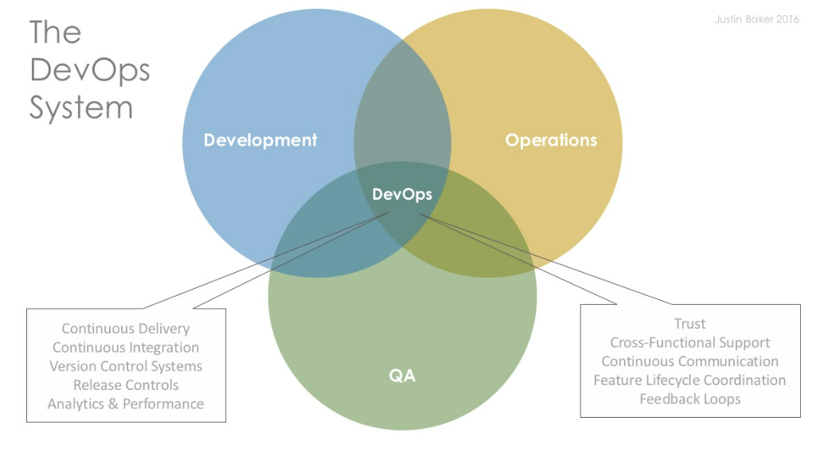
DevOps: Who all are involved?

Slide 4
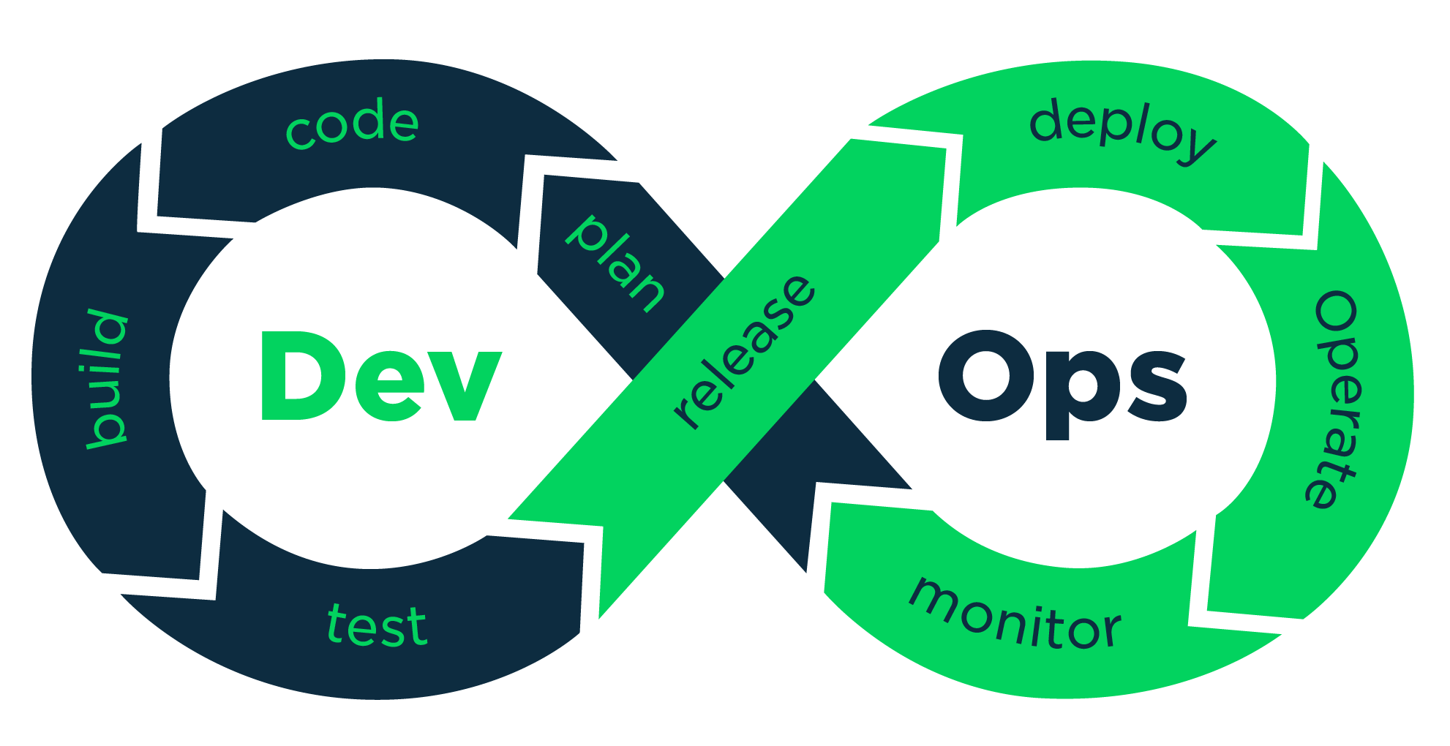
DevOps – 8 Phases

